Slide 1

Simplified OCR
By: Eric Zhou

Slide 2
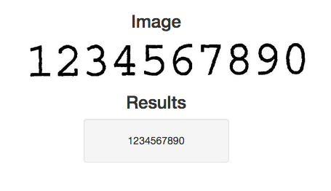

Project Overview
Project: Simplified OCR for letters and numbers
Problem: Accurate recognition of characters in an image
Question: How can machine learning concepts be used with computer vision to do OCR?
Optical Character Recognition (OCR): Recognition of text through computer vision (CV) and character recognition
Text Detection (CV) + Text Recognition (CNN)

Slide 3
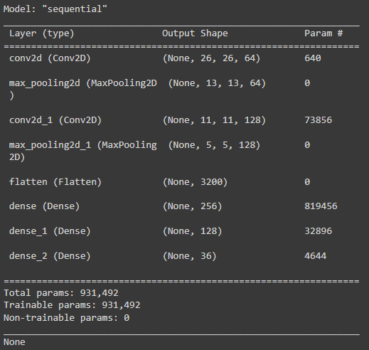
Data & ML
Datasets
MNIST dataset built into Keras (60,000 datapoints: 28x28 grayscale images of handwritten digits)
Kaggle A-Z CSV (372,451 datapoints: 28x28 grayscale images of handwritten capital letters)
Machine Learning Algorithms
Convolutional Neural Network (CNN): For recognizing alphabet + numbers
2 sets of Conv2D layers and Max Pooling layers, flatten, 3 dense layers

Slide 4
Project Trajectory
Cleaning and Working with Data
Convolutional Neural Network
Building and training CNN (Google Colab to make it faster)
Testing on test data
OCR Image Preprocessing and Locating Characters (Most Difficult)
OCR Predictions with CNN
Lots of Tuning (Most Time Spent)
Overall, I think this project went surprisingly well. Although I did get stuck on some parts, it was a lot more accurate than I expected it to be. Rather than bugs, I spent more time figuring new things out and tuning numbers.
To Further Improve:
Train model for longer and on more data
Testing other ways of preprocessing
More preprocessing (e.g., tilt readjustment)
Postprocessing (Dictionary and finding closest word/words)

Slide 5
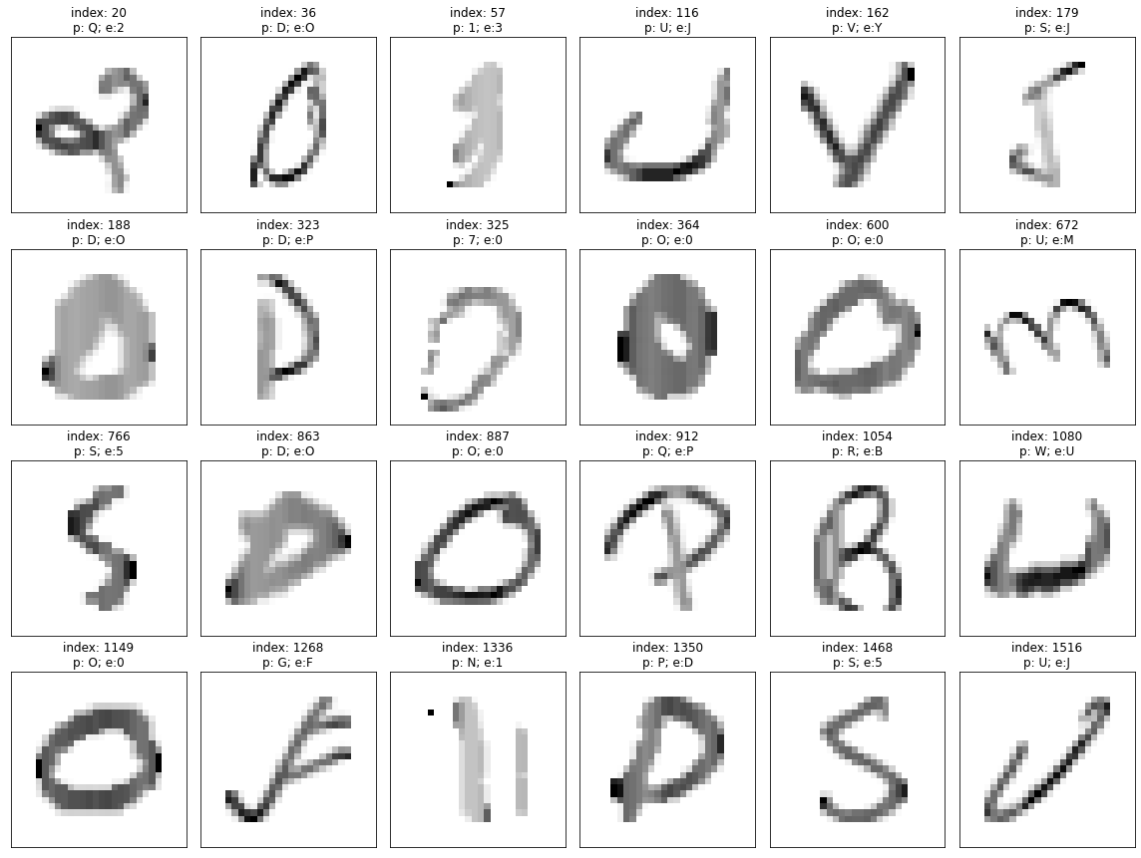
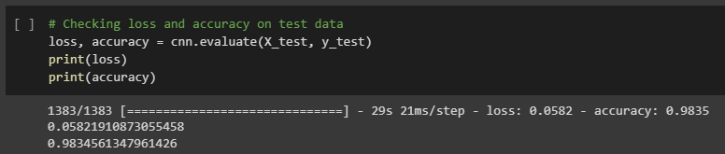
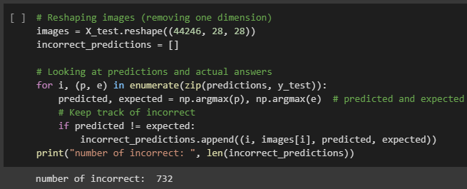
Model Demo

Slide 6
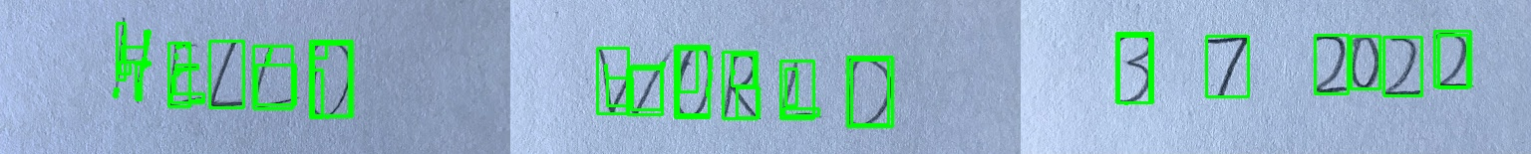
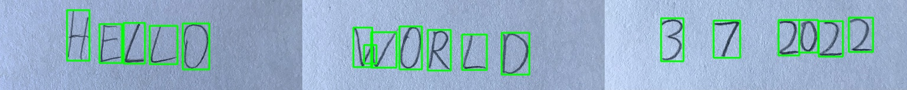
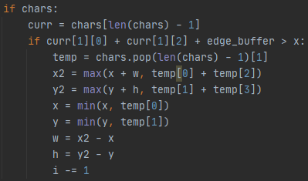
Bug
Multiple Bounding Boxes for Each Letter
Solution: Combine all overlapping boxes (based on x) into 1 using the very outer points of all overlapping boxes to include all necessary parts
Able to fix boxes that were completely overlapping but had some problems with ones that were partially overlapping
Because I calculated x and y first and replaced it with a new number, the result for width and height were the same as the original box no matter what
Calculate x2 and y2 (bottom right point) first and then update x and y as well as w and h

Slide 7
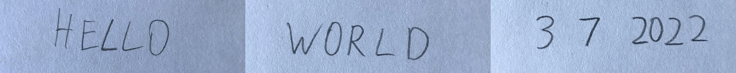
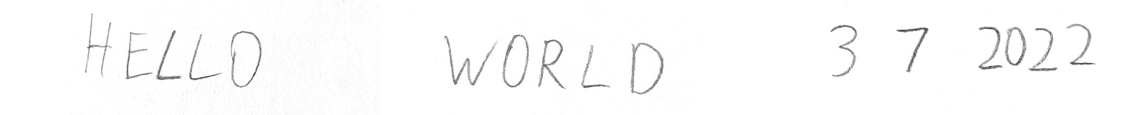
OCR Demo

Slide 8
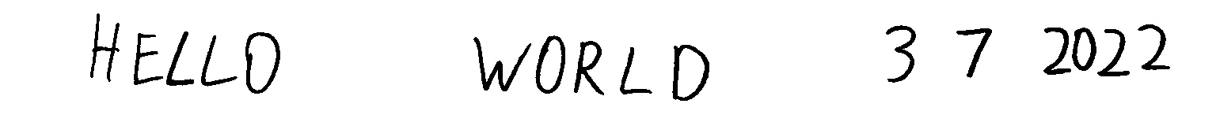
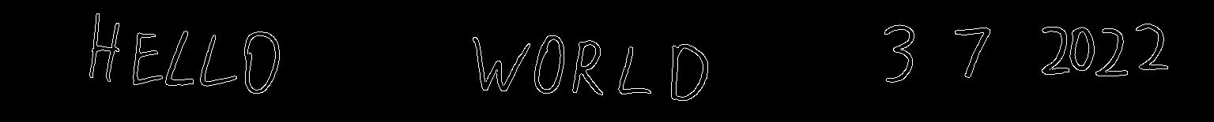
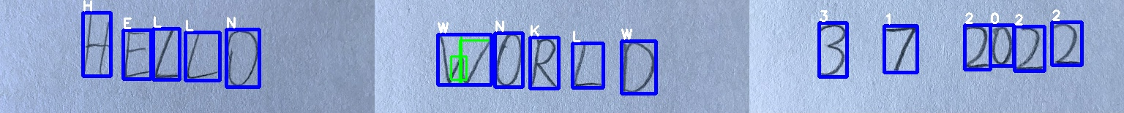

Slide 9
Final Result

Slide 10
Sources
Research/References (All March 2022):
Class code
Combining Data: https://www.kaggle.com/medali1992/resnet50d-train-mnist-a-z
Finding Text: https://www.geeksforgeeks.org/text-detection-and-extraction-using-opencv-and-ocr/
OpenCV Resources:
Brightness + Contrast: https://docs.opencv.org/3.4/d3/dc1/tutorial_basic_linear_transform.html
Thresholds: https://docs.opencv.org/4.x/d7/d4d/tutorial_py_thresholding.html
Images:
https://929687.smushcdn.com/2633864/wp-content/uploads/2020/08/ocr_handwriting_reco_header.png?lossy=1&strip=1&webp=1
https://files.realpython.com/media/results2.5d8d3b8108cd.png

